Slide 1

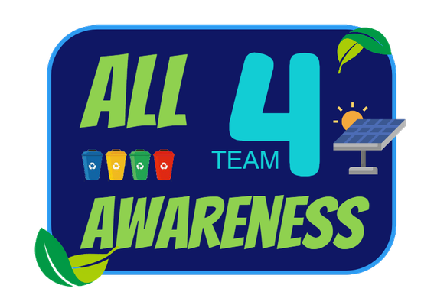

Slide 2
MEET OUR TEAM
Zofia Duda
Filip Tworus
Aleksander Moszyński
Joanna Nowicka
Izabela Zajdel
Claude Mfitumukiza

Slide 3

OUR TARGET GROUP
IFE
Students

Slide 4
RESEARCH
1
Survey
2
Interwievs
3
Prototype

Slide 5
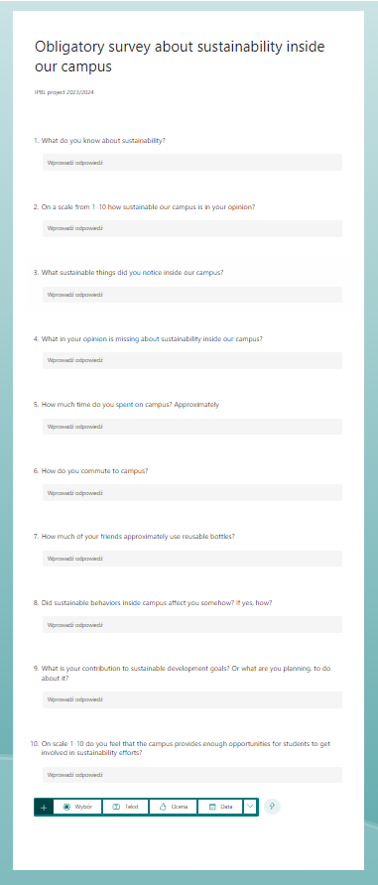
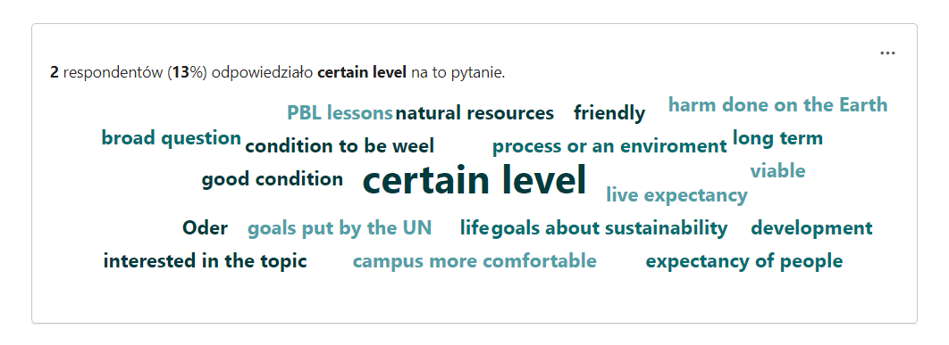
1
Survey
19 responses

Slide 6
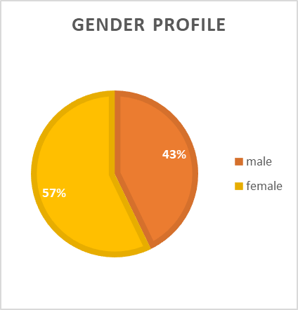
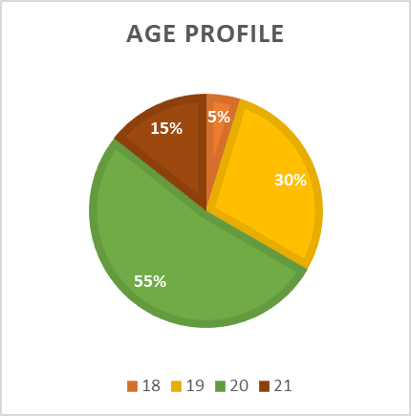
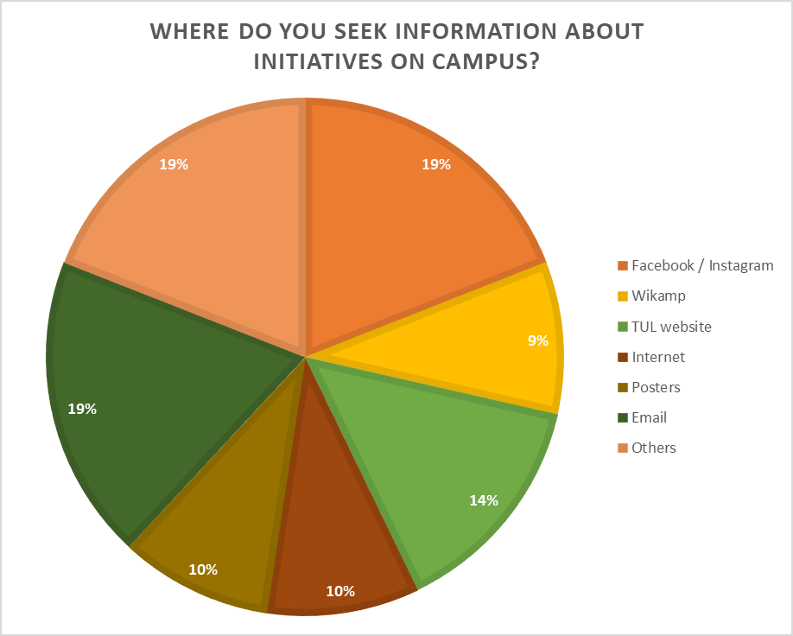
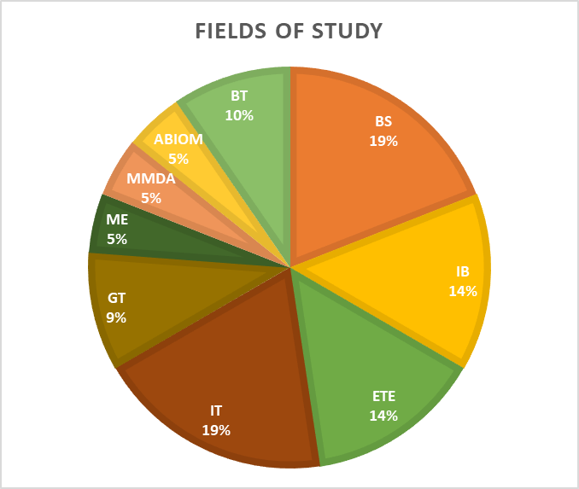
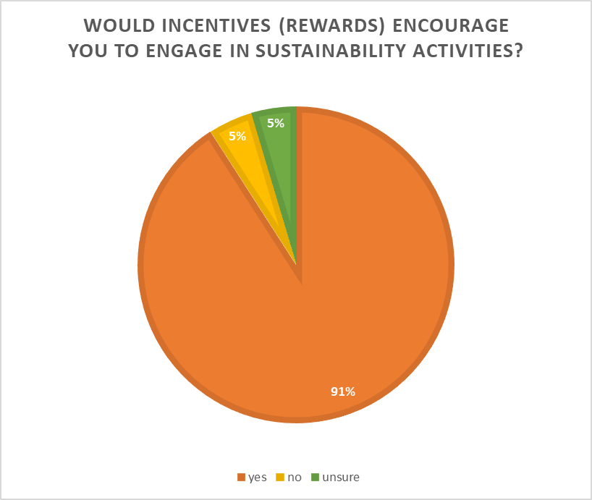
2
Interwievs
21 responses

Slide 7


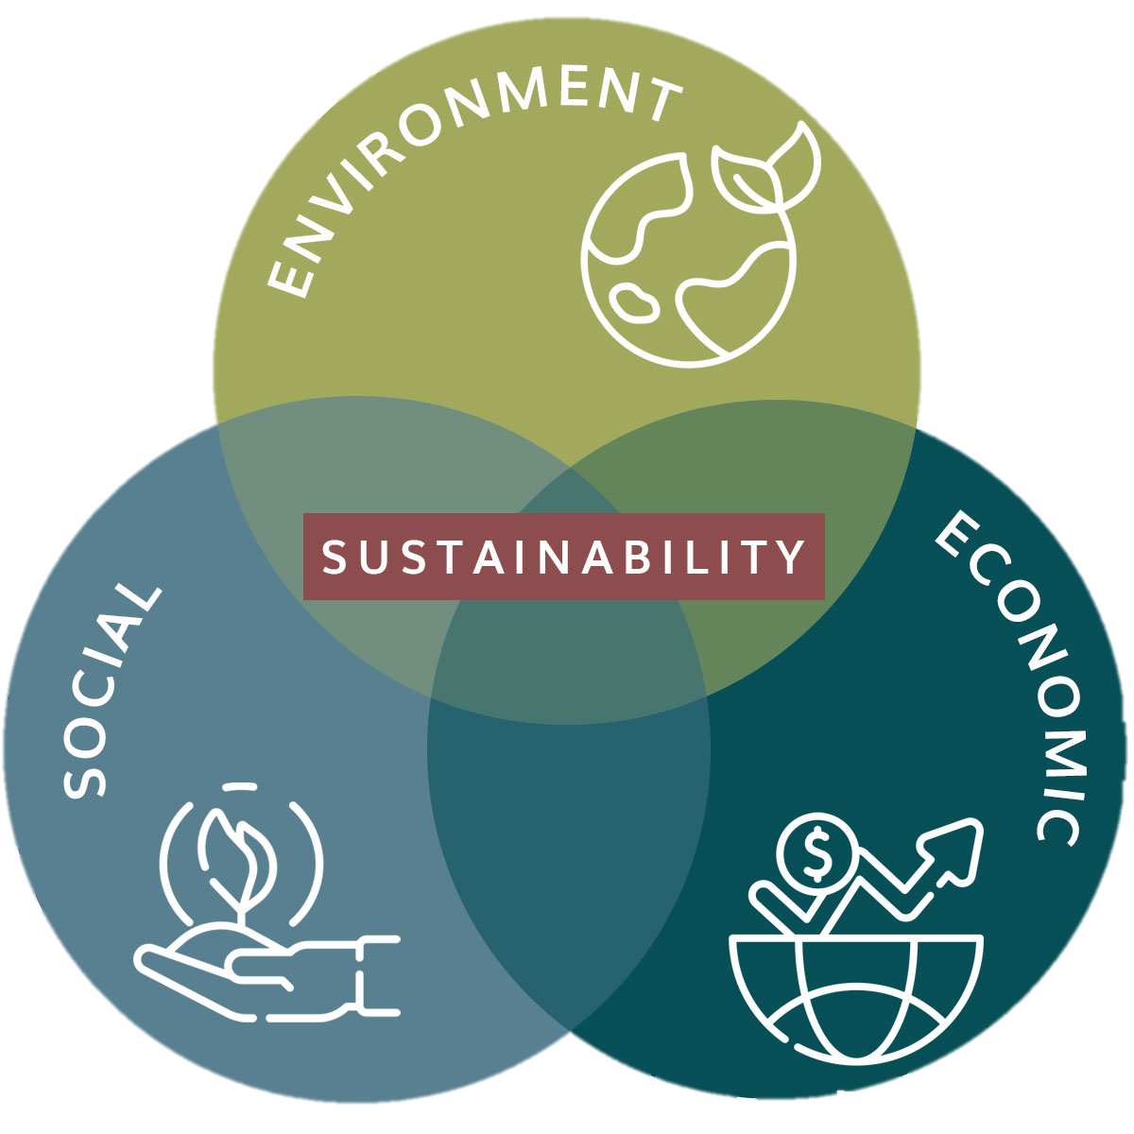

Students admit, they aren’t aware of the initiatives taken by the university.
INTERVIEW
CONCLUSIONS
CONCLUSIONS
They would participate in sustainability initiatives if they were to be rewarded.
Information about sustainability is not visible enough and not encouraging enough.

Slide 8



PROBLEM DEFINITION
Lack of awareness about sustainablity among the students caused by ineffective promotion. Lack of motivation to participate in sustainability due to not enough rewards and outcomes of such actions.
Notes:
During our research, we realized that sustainability isn't promoted well enough. Many students didn't even know what this concept entails, and others only narrowed it down to ecological problems. Taking all of our analysis into consideration, we concluded that the issue we'd like to tackle is the lack of awareness of sustainability—what it really is, how it can affect individuals, and that it isn't something that will demand a lot from them but can make their lives and others' better

Slide 9
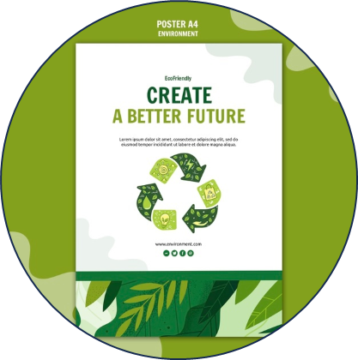
POSSIBLE SOLUTIONS
PARWISE COMPARISON – INTUITIVE DATA
 | Posters | Interdisciplinary Problem-based Learning Project | Study Skills | Civic knowledge & Engagement | Social media campaigns | Sustainability stands
Posters | X | IPBL Project 3 | Study Skills 3 | Civic knowledge & Engagement 1 | SM campaigns 5 | Sustainability stands 5
Interdisciplinary Problem-based Learning Project | X | X | Study Skills 1 | PBL 3 | SM campaigns 3 | Sustainability stands 1
Study Skills | X | X | X | Study Skills 1 | SM campaigns 3 | Sustainability stands 3
Civic knowledge & Engagement | X | X | X | X | SM campaigns 3 | Sustainability stands 3
Social media campaigns | X | X | X | X | X | Sustainability stands 3
Sustainability stands | X | X | X | X | X | X

Slide 10
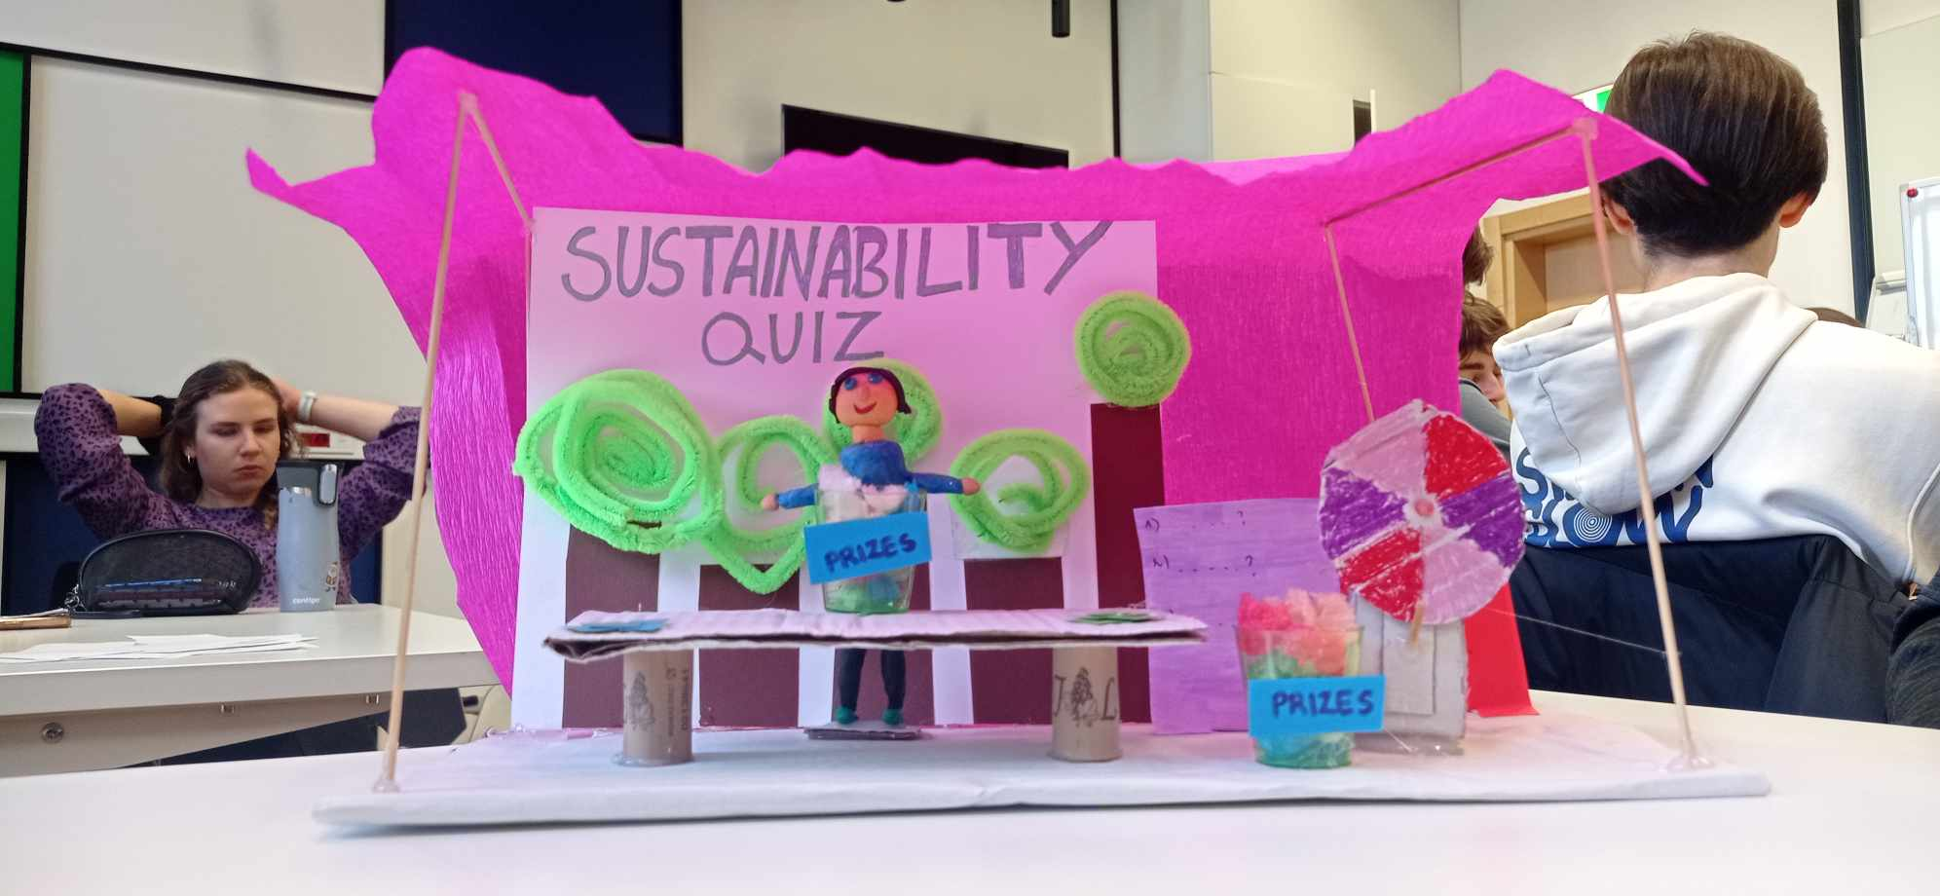
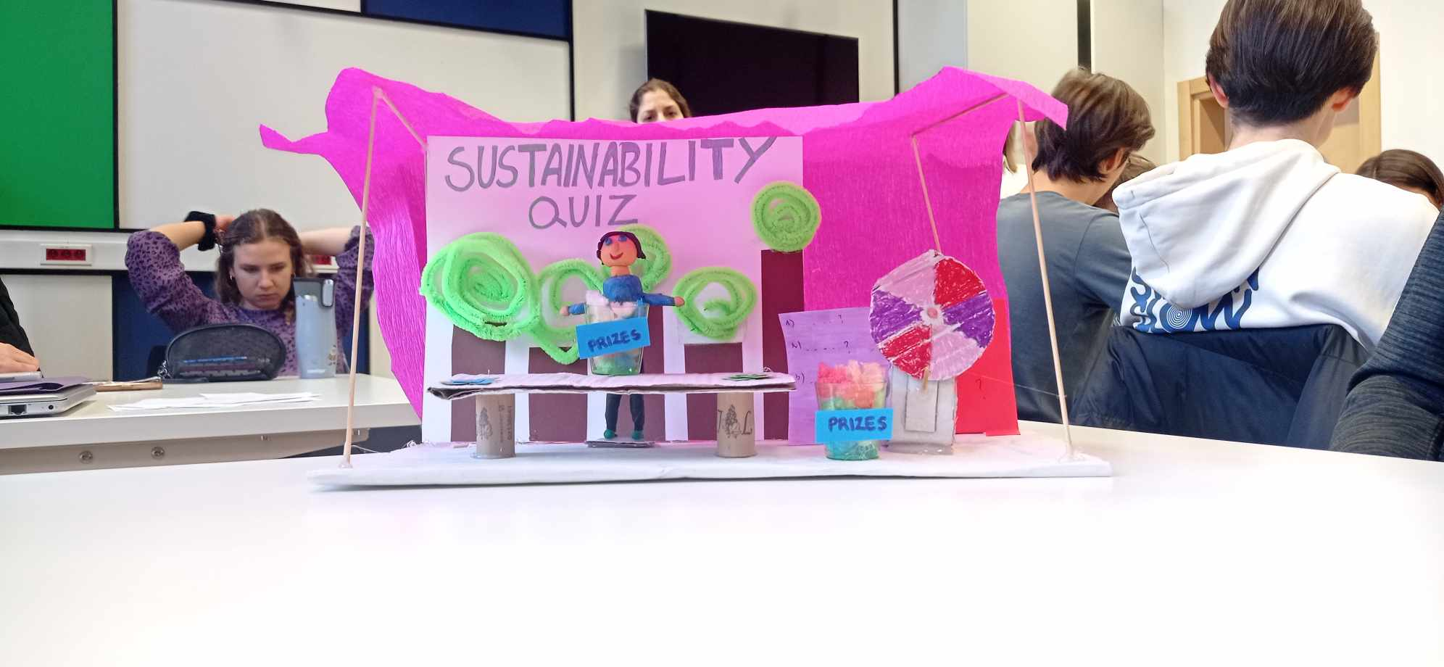
PROTOTYPE
Sustainability stand
Quiz about sustainability
Informative brochures
Prizes to encourage students

Slide 11

FEEDBACK ON PROTOTYPE
18 people interviewed
Positive response
What needed alteration
"Very well-made prototype, that has good design and captures attention."
"Idea of educating people is the greatest thing, it will force them to think more about what they are doing in everyday life, it will increase awareness and decrease the wrongfulness of their actions."
"The concept of sustainable-related prizes is great, it will definitely encourage people to participate."
Persuading people who are not at all interested in sustainable topics
Communication, choosing proper channels to inform about students’ initiatives

Slide 12
SOLUTION - REFLECTIONS
The idea of creating sustainable quizzes caught the attention of reviewers
The aspect of sharing crucial knowledge using those quizzes is well accepted by prototype reviewers
Upgrading our idea by implementing new features will ensure more participants
Proper way of promoting the whole initiative will be significant to accomplish our sustainable goals

Slide 13
SOLUTION
Flexible sustainability stand
Will be held in different buildings at TUL
Stand includes such activities as:
Quizzes about idea of sustainable campus
Informative brochures
Lively discussions with other participants

Slide 14
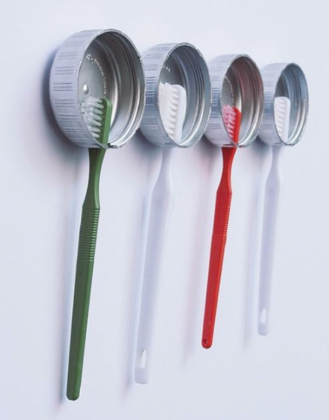
SOLUTION
Flexible sustainability stand
Attractive prizes to motivate participants
Promotion of those events will be conducted through social media channels in campaigns format
Prizes are also planned for those who will spread the information about this chain of events and for those who will perform their own sustainable activities at TUL and present them to stand representatives.
As prizes we consider recyclable gadgets such as bottles,toothbrush holders,flowerpots etc.

Slide 15
Thank you
for your attention
Zofia Duda Mfitumukiza Claude
Izabela Zajdel Joanna Nowicka
Aleksander Moszyński Filip Tworus
Authors:

